Slide 1
“E-Cloth Store”
Supervised By
MD. NESARUL HOQUE
Assistant Professor
Dept Of CSE
BSMRSTU
Proposed By
Fahad Ibna Mahmud
ID:20141201024
BSMRSTU

Slide 2
Presentation Outlines
Introduction
Objective
Related Work
Proposed System
Features
Limitation
Conclusion

Slide 3
Introduction
E-Cloth Store is an online based website.
Customer can view product image, description, they can buy product easily.
Organisation can add their product for make their shop profitable.
Customer must have to sign up for buy any cloth at one time.

Slide 4
Objective
To provide information of various type of cloth.
To make shopping more eassier.
To create service for organization who want to sell cloth through website.
To provide saving time in finding particular product.

Slide 5
Related Work
Their are many website which is related with E-Cloth Store like daraz,ajkerdeal etc.

Slide 6
Proposed System
Data Model
Process Model
Use Case Diagram
User Interface

Slide 7
Data Model
Data Model is a conceptual representation of the data structures that are required by a database.
Entity-Relation Diagram(ERD) shows design of database which is shown in next slide.

Slide 8
Entity Relationship Diagram

Slide 9
Process Model
A Process Model tells us how data flows from one table to another to gather the required information. Here i discussed below
System Data Flow Diagram
Customer-Authentication Context DFD

Slide 10
System Data Flow Diagram
Data Flow Diagrams show the flow of data from external entities into the system.
Data flow diagrams (DFDs) shows relationship among and between the various components in system which is shown in next slide.

Slide 11
System Data Flow Diagram(Cont..)

Slide 12
Customer-Authentication DFD

Slide 13
Use Case Diagram
A use case diagram shows the relationship between the user and the different use cases.
Use case diagram of the system is shown in next slide.

Slide 14
Use Case Diagram(Cont...)

Slide 15
User Interface
My application is user oriented.
Here three types of user can view my website
Visitor
User
Organizational Store

Slide 16
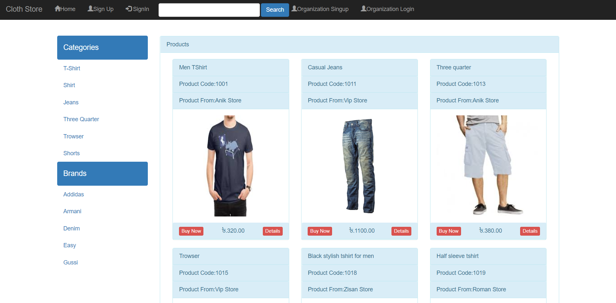
Home Page

Slide 17
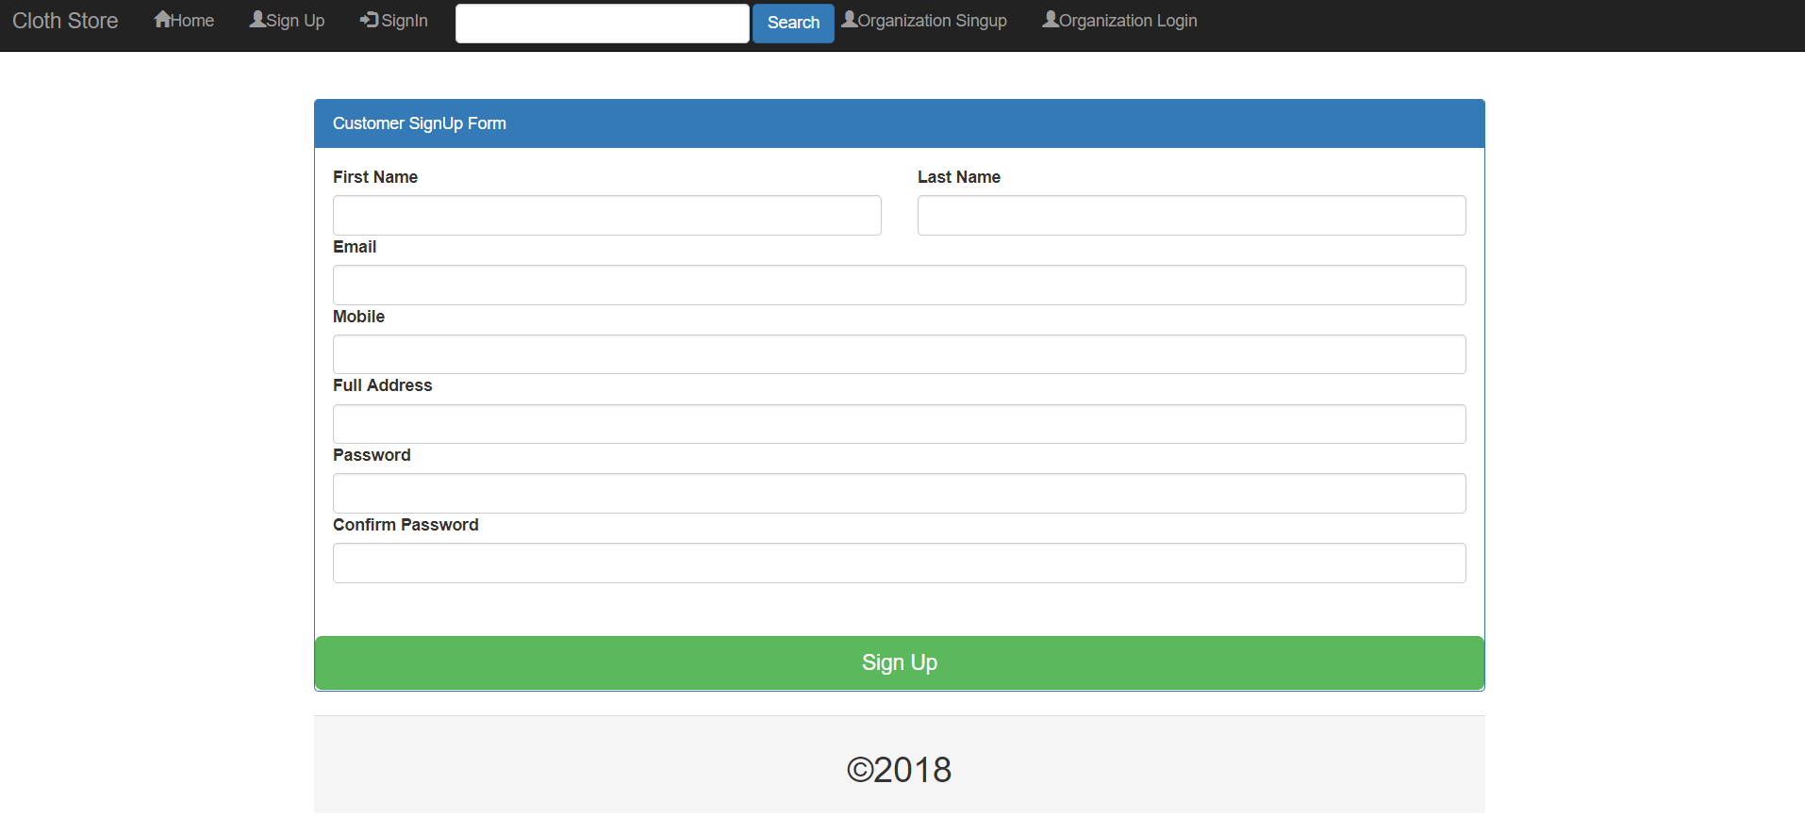
User Sign Up Page

Slide 18
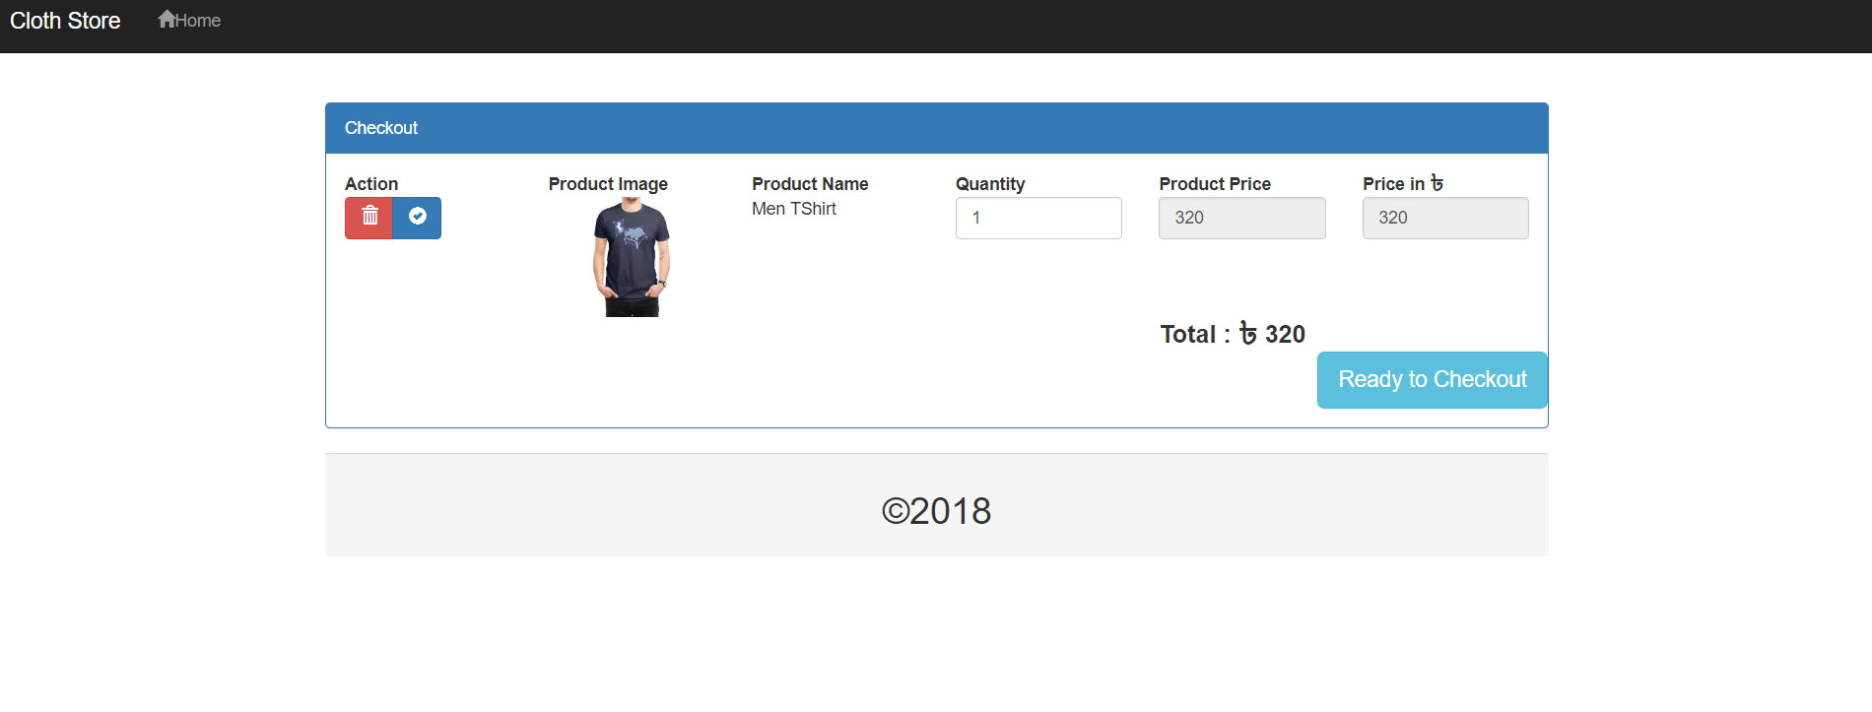
Checkout Page

Slide 19
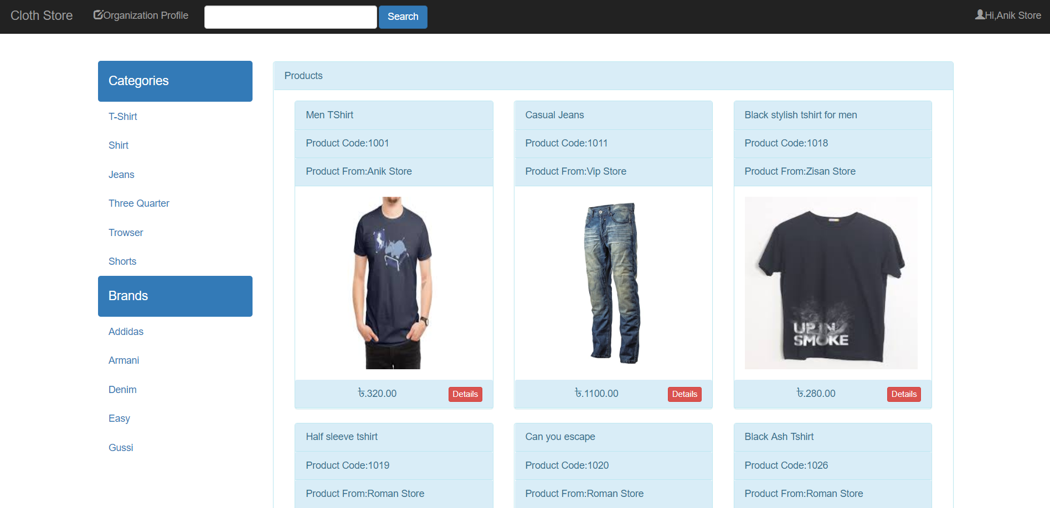
Organisational Store Page

Slide 20
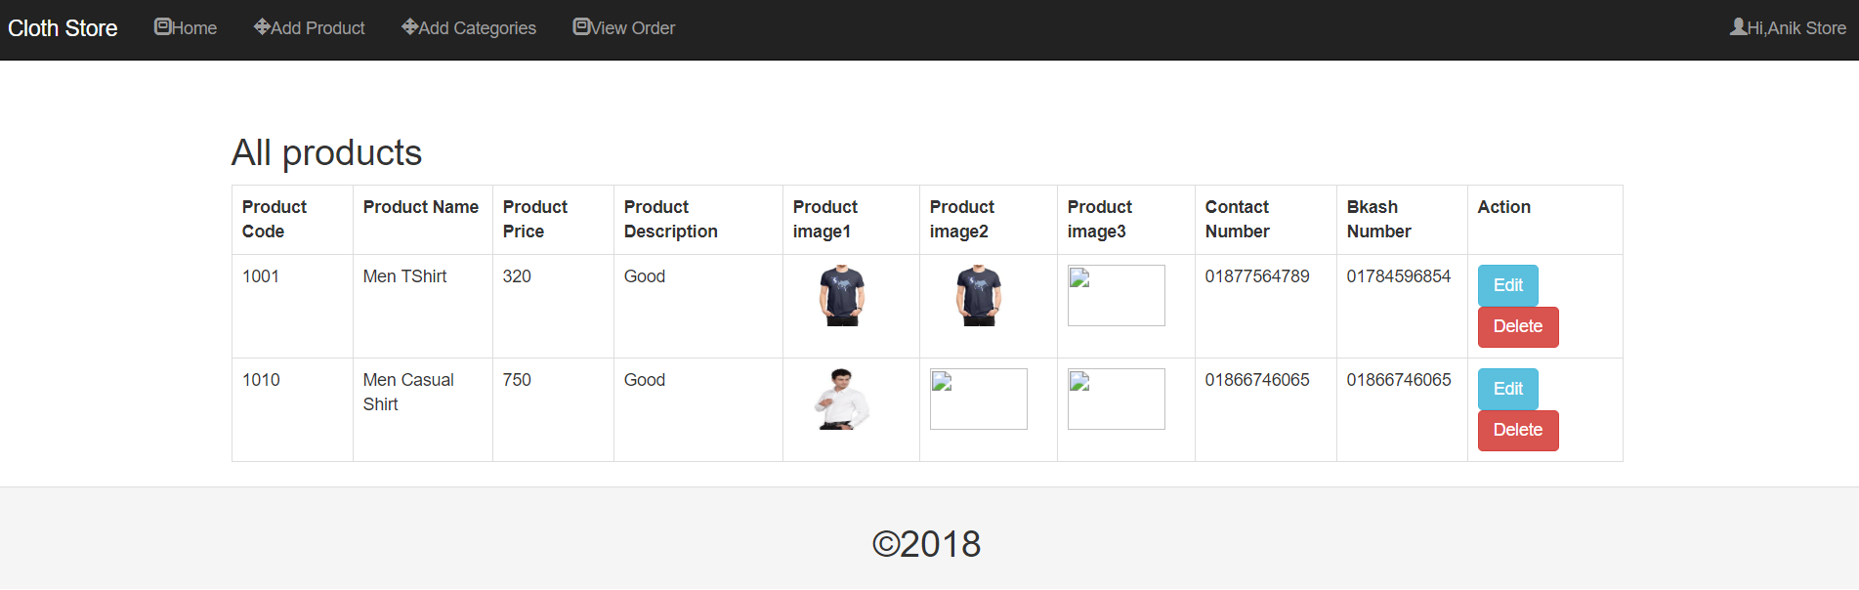
Edit/Delete Page

Slide 21
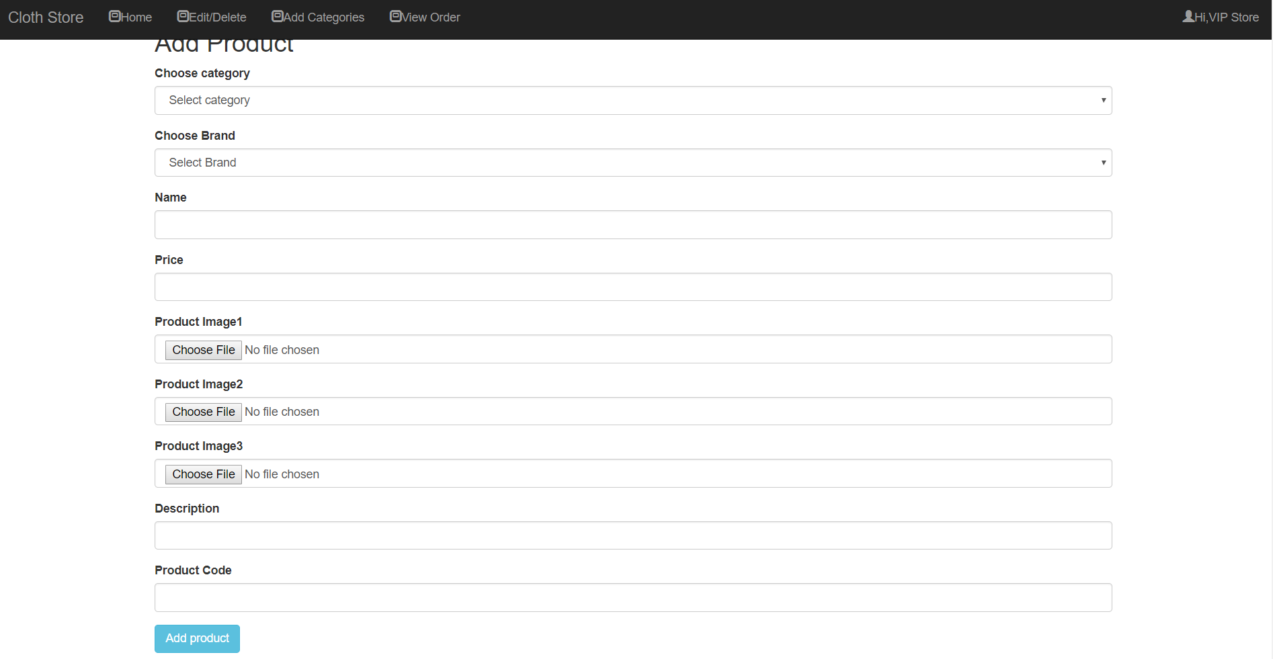
Add Product

Slide 22
Features
There are many catagories.
There are many brands.
Payment option is bkash or cash on delivery.

Slide 23
Limitation
Video review of cloth.
Chatting option with organization.
Cloth size measurement.

Slide 24
Conclusion
This website is very helpful and useful for people who do not want to go market but loves to buy cloth from online shopping.
It will save customer time and travel cost.
Customer once authenticated they can buy any product and pay their product by bkash or can pay latter.

Slide 25
THANK YOU

